Slide 1
Shri Vaishnav Vidyapeeth Vishwavidhalaya
Topic – Crowd Density Management
5
Submitted To Submitted By
Mr. Gaurav Thulla Palash Joshi : 17100BTCMCI01685
Abhishek Dubey : 17100BTCMCI01655
Himanshu Mundhada : 17100BTCMCI01674

Slide 2
Problem Statement
Along with the increase in human population, there has been a signiﬁcant growth in the possibility of crowd gathering at public places. This has called for the need of an effective crowd management technique to ensure crowd safety . Monitoring the density of the crowd and keeping it to a safe and permissible limit is required. Difﬁculty in manually monitoring the crowd density has led to much emphasis being given to automated video surveillance based crowd density estimation.

Slide 3
Data Used
Crowd Density Management works in a way that the video file is given as an input to the system. The video is then processed and the number of head counts are given as an output. The video file is recorded with the help of a CCTV camera in which the system is fitted.

Slide 4




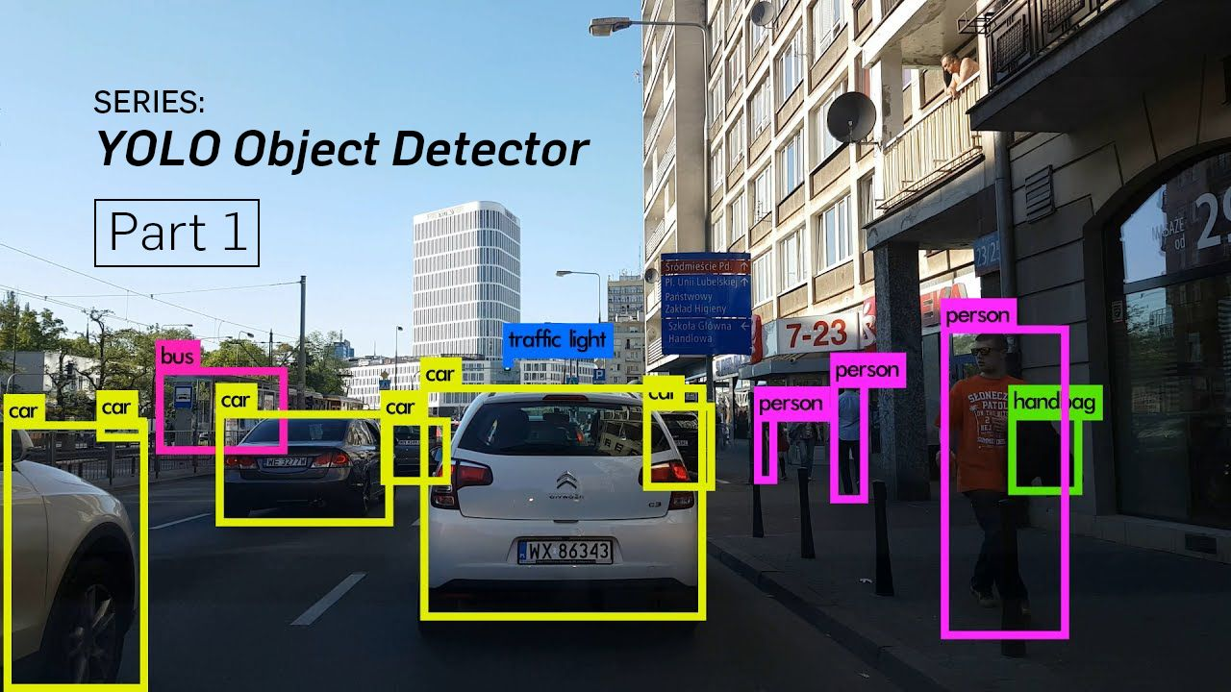
Technology Used

Slide 5
Outcome
The idea behind our project is to develop an intelligent and automated management system . The view of project is to control the crowd with the help of CCTV cameras installed at public places. The outcome is generated through the processed video file which will give us the idea about the number of people entering the area thus helping in limiting the crowd to a particular extent.

Slide 6
Thank You !

